Slide 1
Data Perikanan Siotapina - Lasel
Total landings
CPUE
Size Structure

Slide 2
Total Landings in MAR Siotapina - Lasel
1000
750
Total landings(kg)
500
Stable
250
0
Aug 2019
Feb 2020
Aug 2020
Feb 2021
Aug 2021
Feb 2022
Aug 2022
Feb 2023
Aug 2023
Feb 2024
Aug 2024
Feb 2025
Aug 2025
Feb 2026

Slide 3
Catch Per Unit Effort in MAR Siotapina - Lasel
300
200
Decreased
CPUE (kg/fisher/trip)
100
0
Aug 2019
Feb 2020
Aug 2020
Feb 2021
Aug 2021
Feb 2022
Aug 2022
Feb 2023
Aug 2023
Feb 2024
Aug 2024
Feb 2025
Aug 2025
Feb 2026

Slide 4
Katamba
Lethrinus lentjan

Slide 5
Total Landings L.lentjan in MAR Siotapina - Lasel
100
75
Increased
Total landings(kg)
50
25
0
Dec 2019
Jun 2020
Dec 2020
Jun 2021
Dec 2021
Jun 2022
Dec 2022
Jun 2023
Dec 2023
Jun 2024
Dec 2024
Jun 2025
Dec 2025

Slide 6
Catch Per Unit Effort L.lentjan in MAR Siotapina - Lasel
100
75
Increased
CPUE (kg/fisher/trip)
50
25
0
Dec 2019
Jun 2020
Dec 2020
Jun 2021
Dec 2021
Jun 2022
Dec 2022
Jun 2023
Dec 2023
Jun 2024
Dec 2024
Jun 2025
Dec 2025

Slide 7
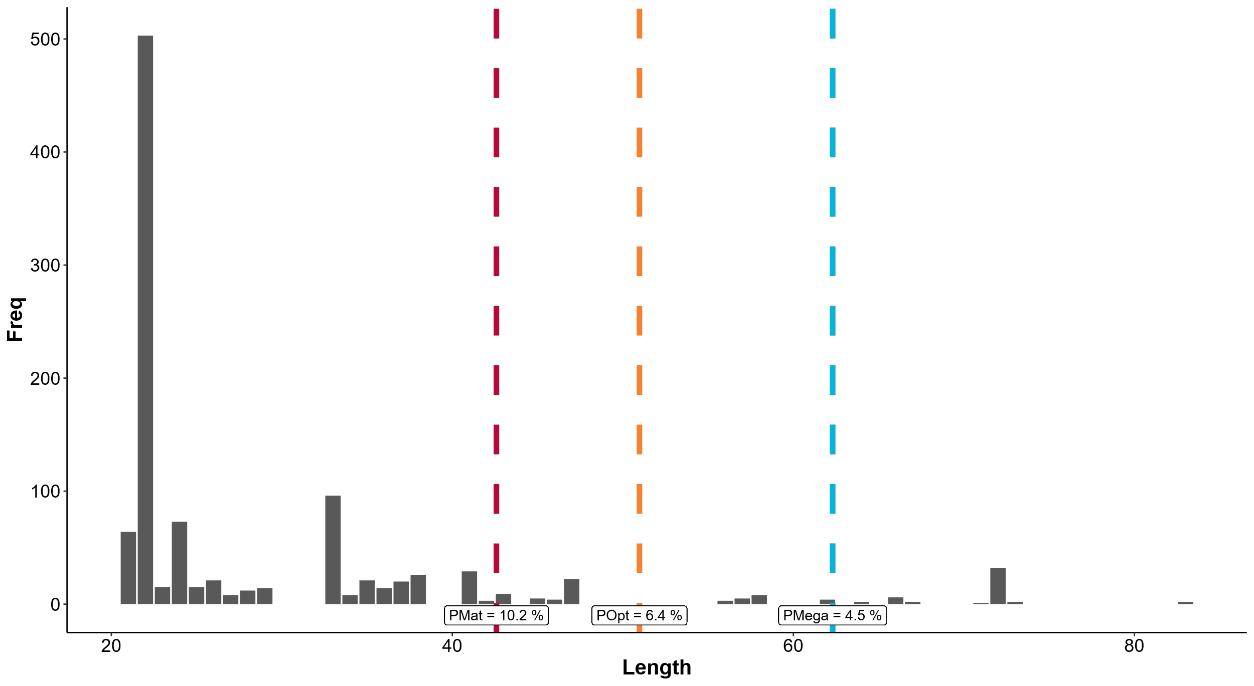

Slide 8
Baronang
Siganus guttatus

Slide 9
Total Landings S.guttatus in MAR Siotapina - Lasel
30
20
Stable
Total landings(kg)
10
0
Aug 2020
Feb 2021
Aug 2021
Feb 2022
Aug 2022
Feb 2023
Aug 2023
Feb 2024
Aug 2024
Feb 2025
Aug 2025

Slide 10
Catch Per Unit Effort S.guttatus in MAR Siotapina - Lasel
20
Stable
15
CPUE (kg/fisher/trip)
10
5
0
Aug 2020
Feb 2021
Aug 2021
Feb 2022
Aug 2022
Feb 2023
Aug 2023
Feb 2024
Aug 2024
Feb 2025
Aug 2025

Slide 11
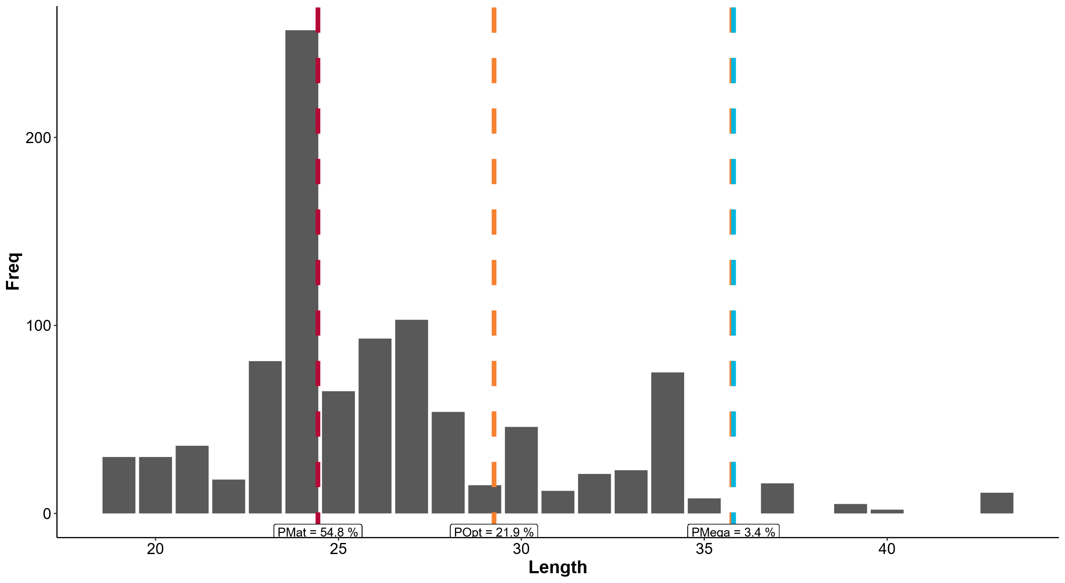

Slide 12
Kepiting Bakau
Scylla serrata

Slide 13
Total Landings S.serrata in MAR Siotapina - Lasel
60
Total landings(kg)
40
20
Stable
0
Sep 2019
Mar 2020
Sep 2020
Mar 2021
Sep 2021
Mar 2022
Sep 2022

Slide 14
Catch Per Unit Effort S.serrata in MAR Siotapina - Lasel
60
40
CPUE (kg/fisher/trip)
20
Stable
0
Sep 2019
Mar 2020
Sep 2020
Mar 2021
Sep 2021
Mar 2022
Sep 2022

